Slide 1
digibudd
Your Digital buddy…
Mentor –
Dr. arun kr Tripathi
Astha Chauhan
Chirag tyagi
Divyanshu
Gunjit dalal

Slide 2
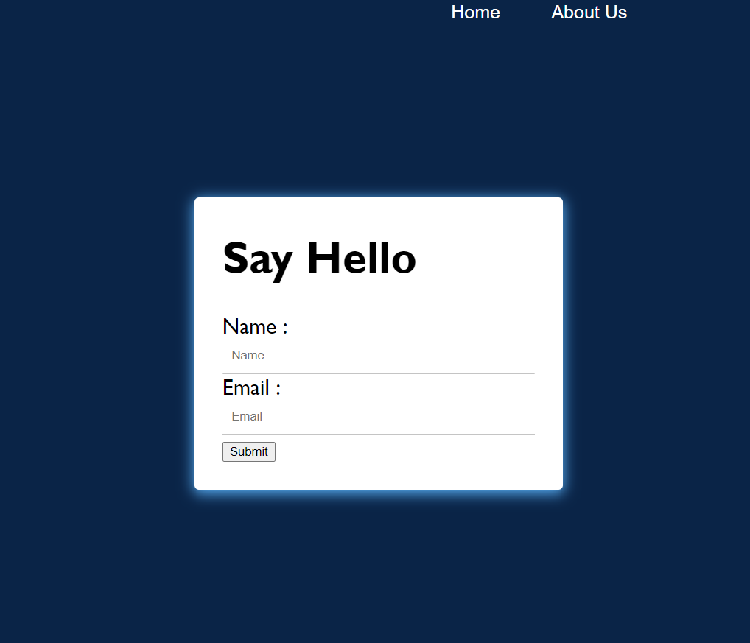
Signup page

Slide 3
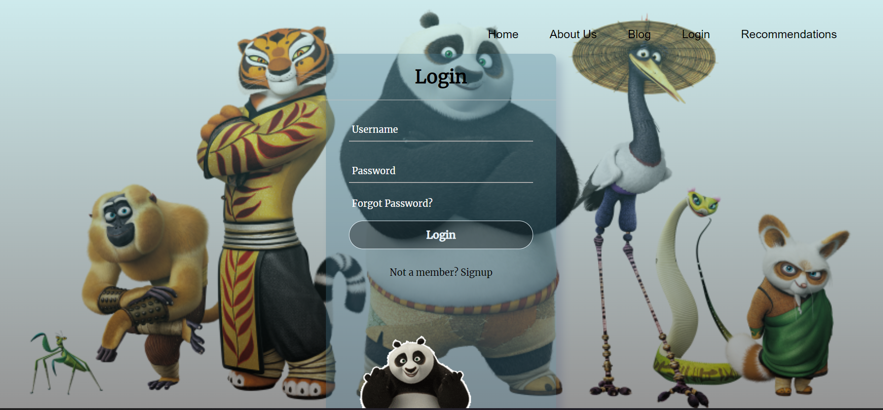
Login page

Slide 4
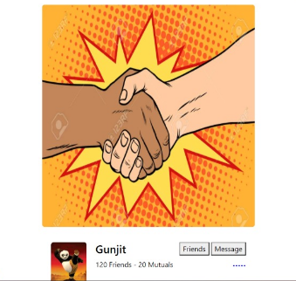
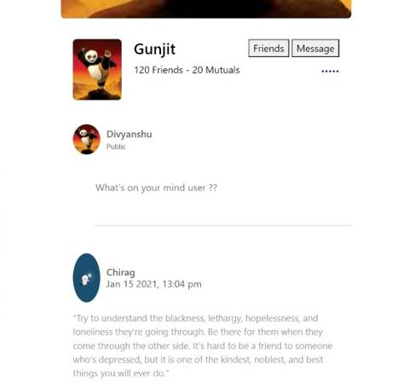
My profile page

Slide 5
DIGIBUDD major FUNCTIONALITIES
BLOG
DIGITAL BUDDY OR DIGIBUDD(CHATBOT)
RECOMMENDATIONS PAGE
PROFILE PAGE

Slide 6
BLOG
Here users will be able to read and share blogs, photos, videos etc.
Main purpose of adding this feature was to let the users interact with each other and enable them to read each other’s inspirational, survival stories, etc to instil the feeling that they are not alone in this situation.

Slide 7
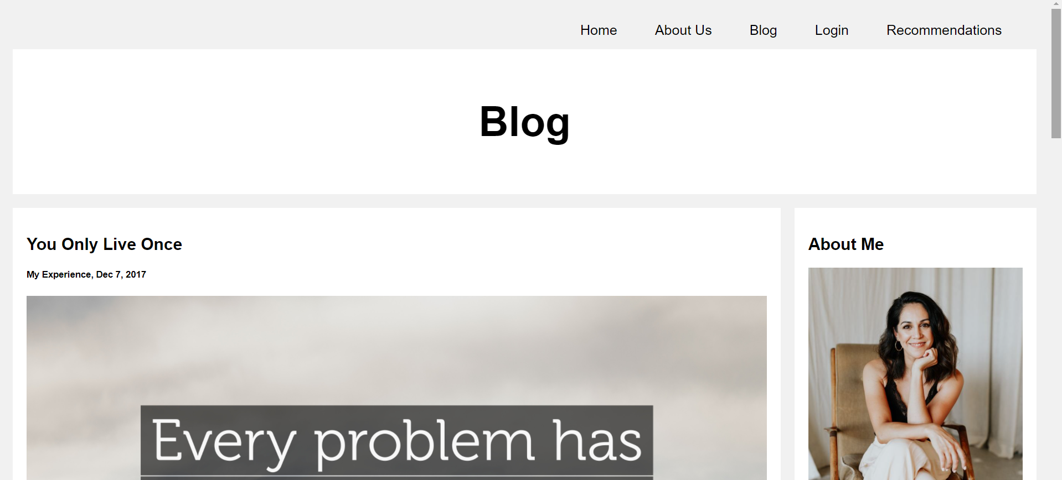

Slide 8
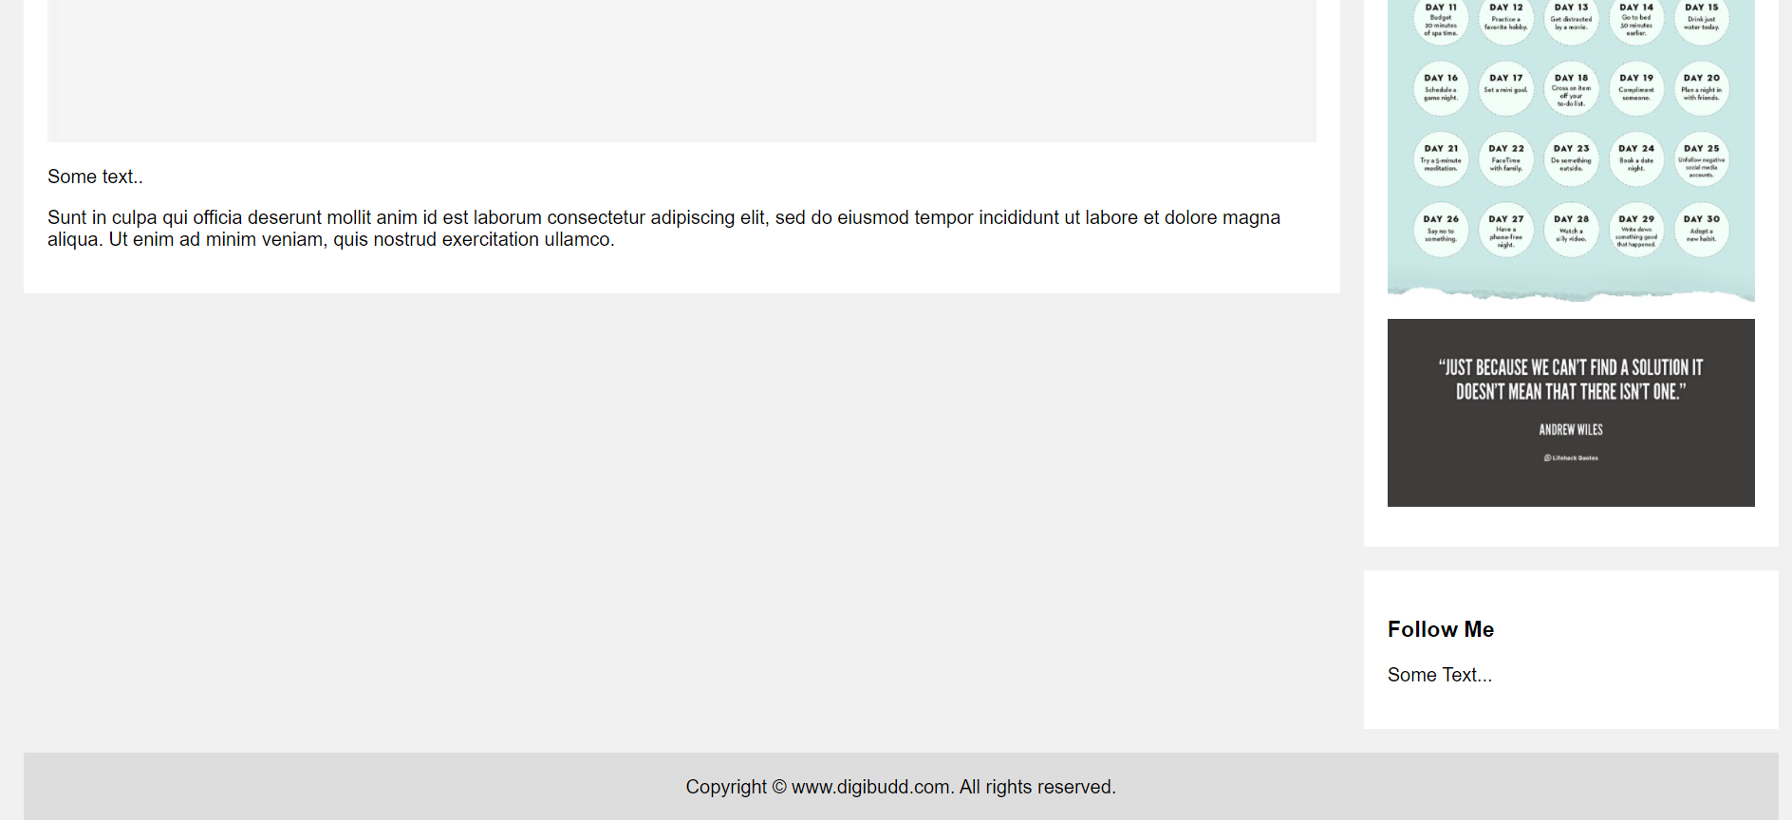

Slide 9
Chatbot
CHATBOT or DIGIBUDD will tell the users more about the situation they are in. All they have to do is to ask DIGIBUDD.
NOT only that, but users can ask DIGIBUDD about how to treat depression and DIGIBUDD will give them some real life practical solutions regarding it.

Slide 10
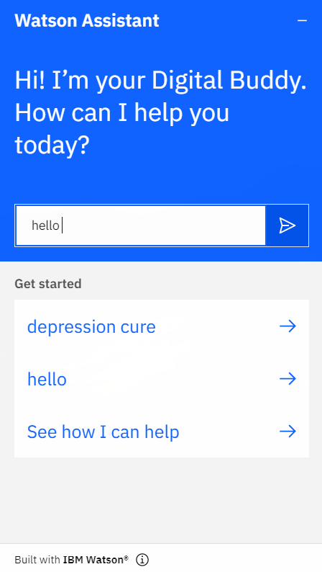
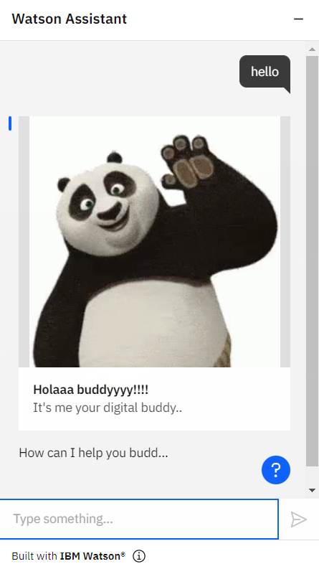

Slide 11
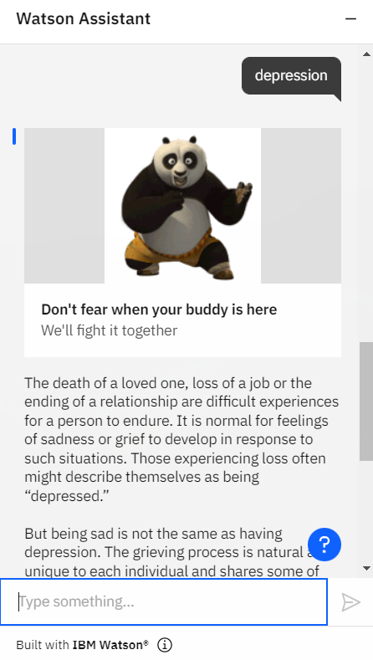
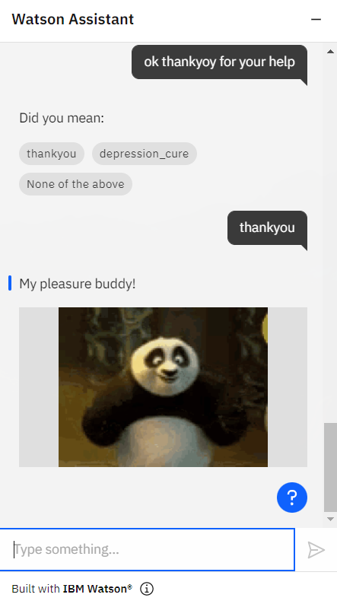

Slide 12
Recommendations page
This page will recommend some of the best books, movies, exercises, music, etc which can improve user’s mood, thus making him/her happy which is our end goal.

Slide 13
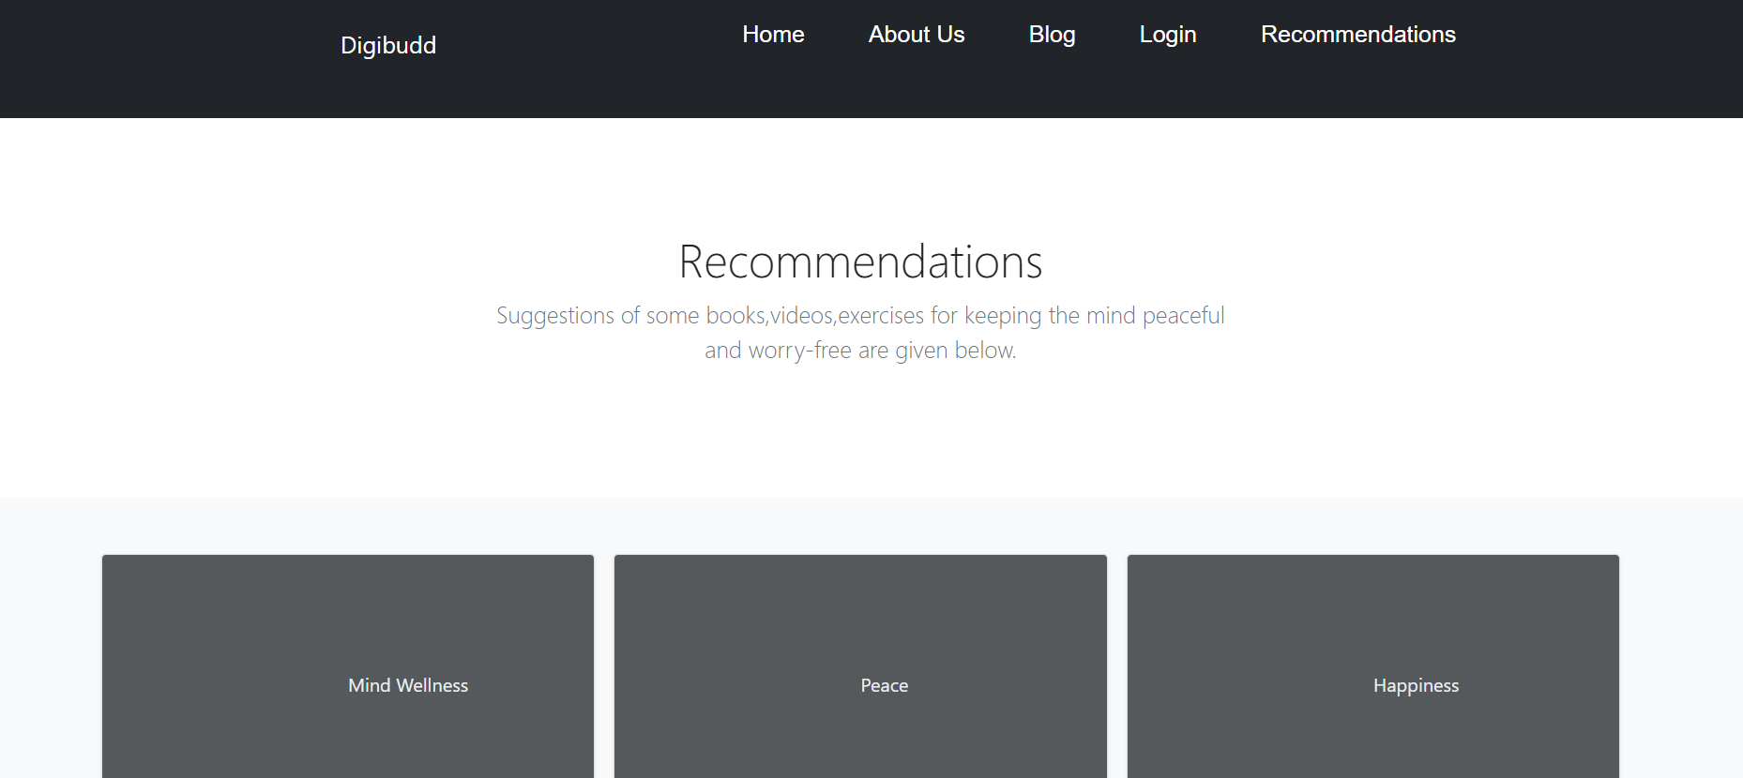

Slide 14
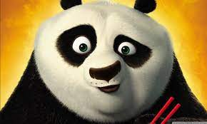
Technologies used
For Front-end
HTML
CSS JAVASCRIPT(JS)
For Back-end
PHP
MYSQL
For CHATBOT
IBM Watson

Slide 15
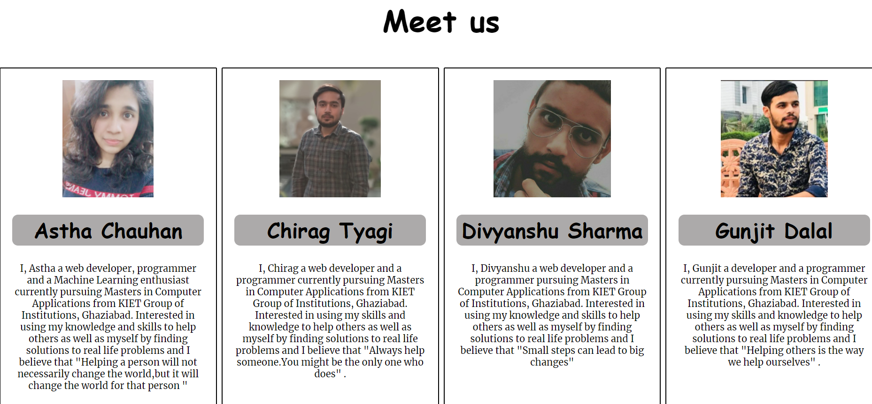
About us

Slide 16
WE AT DIGIBUDD BELIEVE
“IF GAMES LIKE BLUE WHALE CAN INSTIGATE YOU TOWARDS NEGATIVITY, THEN DIGIBUDD CAN SURELY TAKE YOU TOWARDS POSITIVITY!!”

Slide 17
Thankyou!!

